Slide 1
Resource Groups
Logical container for resources

Slide 2
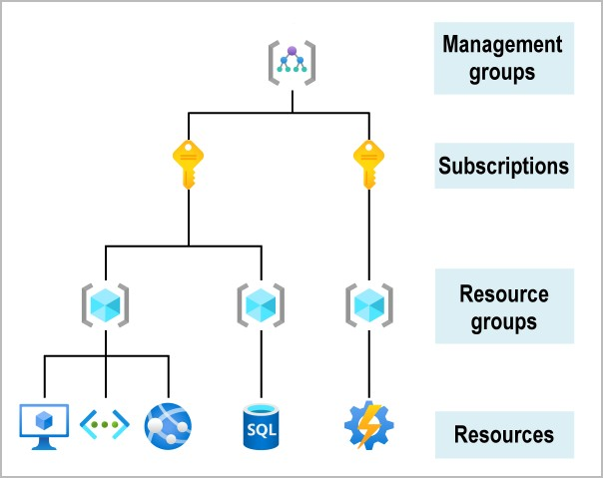
Organizing structure for resources
Resources: Resources are instances of services that you create, like virtual machines, storage, or SQL databases.
Resource groups: Resources are combined into resource groups, which act as a logical container into which Azure resources like web apps, databases, and storage accounts are deployed and managed.
Subscriptions: A subscription groups together user accounts and the resources that have been created by those user accounts. For each subscription, there are limits or quotas on the amount of resources that you can create and use. Organizations can use subscriptions to manage costs and the resources that are created by users, teams, or projects.
Management groups: These groups help you manage access, policy, and compliance for multiple subscriptions. All subscriptions in a management group automatically inherit the conditions applied to the management group.

Slide 3
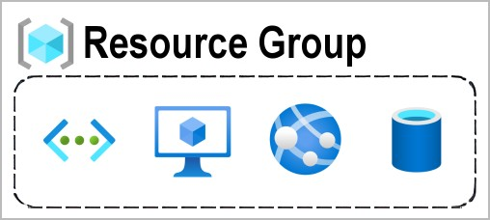
Resource Groups
Resources: are anything you create in an Azure subscription like VMs, Azure Application Gateway instances, and Azure Cosmos DB
instances.
Resource group is a logical container which help manage and organize your Azure resources.
  For example similar usage, type, or location
Each resource can exist in only one resource group.
You can move a resource from one resource group to another group.
Resource groups can't be nested.
The resources in a resource group can be located in different regions than the resource group.
Resource group created at location – to store metadata.
A resource group can be used to scope access control for administrative actions. To manage a resource group, you can assign Azure Policies, Azure roles, or resource locks.
  You can apply locks to a resource group or subscription to prevent deletion or make contained resources read-only. You can also apply locks directly to a resource.
You can apply tags to a resource group. The resources in the resource group don't inherit those tags.
Life cycle: When you delete a resource group, all resources in the resource group are also deleted.
To create a resource group, you can use the portal, PowerShell, Azure CLI, or an ARM template.

Slide 4
Azure Resource Manager
Deployment and management service for Azure

Slide 5
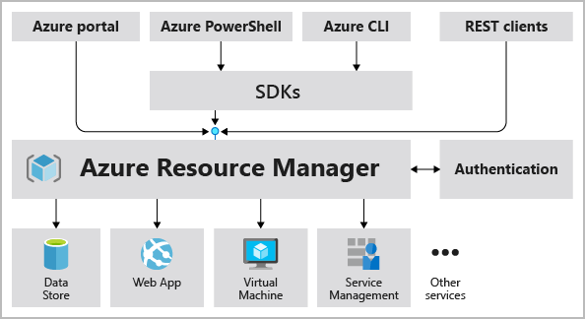
Azure Resource Manager (ARM)
Atomate resource deployments (create, update, and delete) using templates.
ARM template is a JSON file that defines what you want to deploy to Azure.
Integrates with Azure portal, PowerShell, CLI, and REST API to perform deployment and management tasks.
Easy way to deploy multiple resource instances or reliably redeploy resources.
ARM template can be used to deploy the resources consistently and repeatedly.
Define the dependencies between resources so they're deployed in the correct order.

Slide 6
Subscription
How you are billed for resource usage

Slide 7
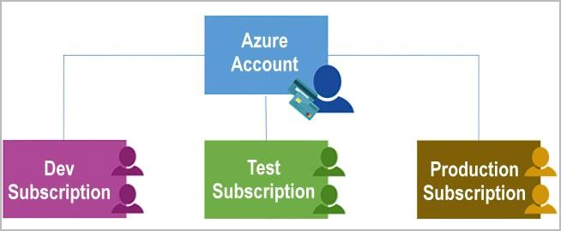
Subscriptions
Using Azure requires an Azure subscription.
An Azure subscription is a logical unit of Azure services that links to an Azure account. It also allows you to provision resources.
A subscription provides you with authenticated and authorized access to Azure products and services.
Azure generates separate billing reports and invoices for each subscription
Two types of subscription boundaries
  Billing boundary
  Access control boundary
You can create separate subscription based on:
  Environment: development and testing, security, or to isolate data for compliance reasons
  Organizational structures: IT, HR, Admin and so on
  Billing: manage and track costs based on your needs, for example – Production, Test and Dev
Different types of Subscription:
FREE: An email address and a credit card are required to sign up for a free trial subscription that provides $200 credit for the first 30 days and 12 months of restricted access.
Pay-Per-Use: Charges monthly based on Cloud resource use.
Enterprise: A single Enterprise agreement is established for large subscription purchases, including savings for new licenses and Software Assurance.
Student: This membership includes $100 for 12 months and may be activated without a credit card.
⮚
⮚
⮚
Ref: https://docs.microsoft.com/en-us/learn/modules/azure-architecture-fundamentals/management-groups-subscriptions

Slide 8
Management Groups
Organize multiple subscriptions as a single management entity

Slide 9
Azure Sovereign Regions

Slide 10
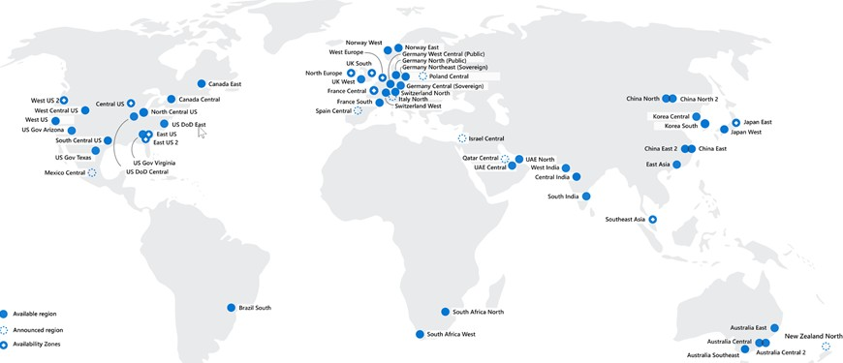
Azure Sovereign Regions
Different from Public Cloud
Specific regions of azure that were created to meet high security and other regulatory and compliance requirements for specific markets
  Azure Government (Only for US government)
  Azure China

Slide 11
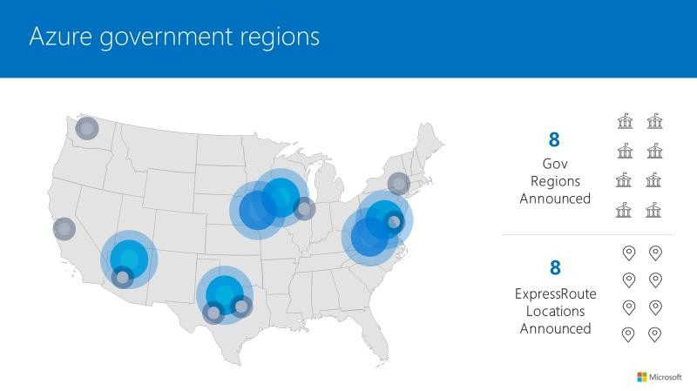
Azure Sovereign Regions
Azure Government
Specially Designed for US government
Azure Government is operated directly by Microsoft.
Separate Instance (https://portal.azure.us)
  Portal experience is same Physically Isolated Datacenters
⮚
Authorized personal only can access services and infrastructure
Azure Government customers that are eligible to use Azure
Government cloud are:
  US federal state
  State or local government agencies or their partners Azure Government is not available for public use.
⮚

Slide 12
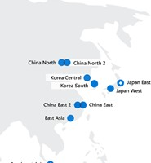
Azure Sovereign Regions
Azure China
Azure China is designed for organizations doing business in China that need to meet Chinese regulations.
Microsoft is not physically running services in China
  Azure China is controlled by a Chinese data trustee (21Vianet).
Azure China is a physically isolated
⮚
Separate instance (https://portal.azure.cn)
All data and related systems physically reside in China.

Slide 13
Data Centers, Regions, Region pairs
  Regions - physical location around the world where we cluster data centers.
Availability Zones
  Availability zone is a set of discrete data centers
  Each availability zone has independent power, cooling and networking.
Learning Outcome
Resource Groups
Resource group is a logical container which help manage and organize your Azure resources.
Azure Resource Manager (ARM)
  ARM template is a JSON file that defines what you want to deploy to Azure.
Subscription
  Azure subscription is a logical unit of Azure services that links to an Azure account
Management Groups
  Organize multiple subscriptions as a single management entity to facilitate easier management.

Slide 14
Azure Compute Services
In Azure, you can create compute resources, configure them to do the work that's needed, and pay for only what you use
What is Compute?
Azure Virtual Machine
Demo: Deploy and resize VMs
Deploy Website on VM
Load Balancer
Learning Objectives
Deploy VMs at Availability Zones
Deploy VMs at Availability sets
Virtual Machines Scale Sets
Azure App Service
Containers
  ACI vs AKS
  Virtual Machine vs Containers
  Azure Container Registry
Azure Virtual Desktop (Windows Virtual Desktop)
➢

Slide 15






COMPUTE
What is Compute?

